Slide 1

Author’s Purpose
Created by Lindsay Flood © 2012 – Polka Dot Border from Graphics from the Pond {TpT}

Slide 2

Define AUTHOR’S PURPOSE:
The reason that the author is writing the book, article, or story.

Slide 3
What is our acronym to remember the 5 different types of Author’s Purposes?
PIE ED!

Slide 4

P
PERSUADE
The author wants to convince you of something!

Slide 5
Wants you to buy something
Wants to conform your beliefs about a product or idea
Types of Persuasion:
    Emotional Appeal
    Bandwagon
    Expert Opinion
    Testimontial

Slide 6


I
INFORM
The author wants to give some kind of information!

Slide 7
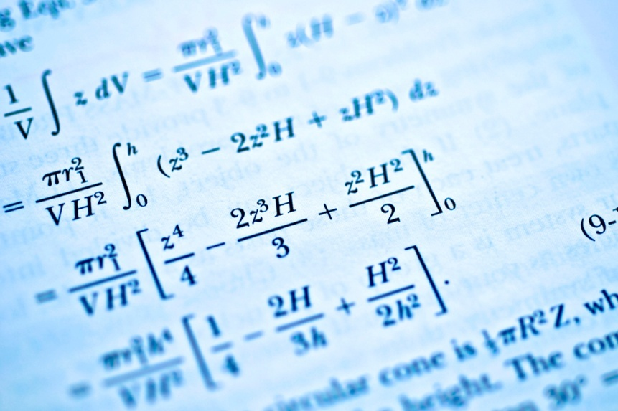

E
EXPLAIN
The author wants to tell you about something, how something works, or how to do something.

Slide 8


E
ENTERTAIN
The author wants you to enjoy the writing.

Slide 9
D
DESCRIBE
The author wants to help you see or experience a place, thing, or person.

Slide 10

World Report: January 23, 2009 Vol. #14 Iss. #15
Kids Say No to Meat
How many kids these days are choosing leafy greens over meaty hamburgers? About 367,000, a new government survey reveals. Parents and other adults were asked about the eating habits of children in their care. The study is the first survey of its kind in the nation. The study did not ask why kids chose to be vegetarians.
Researchers say some kids may be avoiding meat because of concern for animals. "Compassion for animals is the major, major reason," says Richard Schwartz, president of a vegetarian organization.
INFORM – article

Slide 11
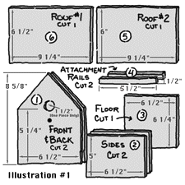
Building a birdhouse is a perfect activity for adults to share with their children or grandchildren. It can be used to teach about birds, as well as the proper use of tools.
This project is the perfect opportunity for parent's to discuss tool safety with their children. Wearing safety glasses is vitally important—flying nails from glancing hammer blows can seriously damage eyes. Hand tools can be very sharp. Improperly used, they pose a serious risk of injury to the user. Loose clothing can get caught in power tools and pull fragile limbs into sharp, rapidly rotating bits and blades. Children should learn that tools are useful and necessary, but they demand respect and attention from their user.
EXPLAIN

Slide 12
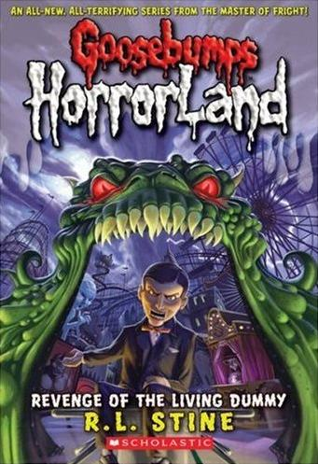
Chapter One
You may wonder why my best friend, Molly Molloy, and I were in the old graveyard late at night.
I shivered as I thought about what we were doing. Wind howled through the trees, and pale streaks of lightning cracked the sky.
“Hurry, Molly,” I whispered, hugging myself as the moon disappeared behind the clouds. “It’s going to storm.”
“I am hurrying, Britney,” Molly said. “But the ground ... it’s really hard.”
We were digging a grave. We took turns. One of us shoveled while the other stood lookout. I felt cold raindrops on my forehead. I kept my eyes on the low picket fence near the street. Nothing moved. The only sounds were the scrape of the shovel in the dirt and a drum roll of thunder, deep but far away.
Across from me, an old gravestone made a creaking sound as it tilted in the wind.
I sucked in my breath. I suddenly pictured the old stone toppling over. And someone crawling out from the grave beneath it.
ENTERTAIN

Slide 13

Chocolate Chip Cookie Recipe
Chocolate chip cookies represent half of the cookies baked in American homes each year. This chocolate chip cookie recipe will produce a treat that is sure to please everyone in your house!
Every Christmas Eve, my little boy and I bake these cookies for Santa Claus, and few for us as well! This recipe has become a special tradition, especially around the holidays! I hope that you and your family can experience the joy and tradition that we do each and every time you pop a dozen of these heavenly morsels into the oven!
Chocolate Chip Cookie Ingredients
• 3/4 cup sugar
• 3/4 cup packed brown sugar
• 1 cup butter, softened
• 2 large eggs,beaten
• 1 teaspoon vanilla extract
• 2 1/4 cups all-purpose flour
• 1 teaspoon baking soda
• 3/4 teaspoon salt
• 2 cups semisweet chocolate chips
• if desired, 1 cup chopped pecans
DESCRIBE

Slide 14

Preston County Animal Shelter
Every year at the Preston County Animal Shelter, we take in and rescue hundreds of stray cats and dogs that need a good home. Currently, because of the cold weather, we are having an overwhelming abundance of stray and dropped dogs.
Please consider adopting one of our precious furry friends. Just imagine, what if you were alone, stranded in the cold with no where to call home? If you come and adopt one of our dogs, the Preston county Animal Shelter will give you 6 months of dog food for free!
Please don’t let these poor animals suffer any more! You are their only hope in this world, and right now, hope is all they have.
Preston County Animal Shelter…
So much more than a Shelter.
PERSUADE

Slide 15
If you are reading a fiction novel, you will most likely be reading this novel because:
It informs you about important facts
You need to understand how gravity works
You enjoy the entertainment it brings
You are hoping to experience the thrills of the Rocky Mountains

Slide 16
In last night’s newspaper, you read about the increase of bicycle sales because the high gas prices.
The author wrote this article to:
Explain how bicycles are made
Inform you of bicycle sales
Entertain you with bicycle tricks
Describe how hard it is to ride a bicycle

Slide 17
Do you have a closet full of old coats that are just hanging around collecting dust? Well, if you do, this Saturday at Second Baptist Church, we will be collecting old coats and jackets to pass out to the homeless in our communities. Please drop off your jackets and coats in the church office by Wednesday afternoon at 4:00.
The people in our community need you more than they ever have! Please take a moment to go through your closet and give to those that are less fortunate than you are!
The author wrote this particular advertisement for a local community newspaper to:
Explain why the homeless need coats
Describe what it’s like to have a new coat
Inform you about how cold the weather has been lately
Persuade you to give your old coats and jackets to the less fortunate

Slide 18
Roller coaster enthusiasts from around the world voted The Voyage the #1 Wooden Coaster on the Planet in 2007!
The world's top "air-time" wooden coaster is the main course at Holiday World's Thanksgiving section!
"The Voyage is an air-time machine, with riders experiencing a feeling of weightlessness for a total of 24.2 seconds," says Will Koch, the parks' president. "We take the traditional out-and-back layout to the extreme, with one of the steepest drops on any wooden coaster in the world. The Voyage is 1.2 miles long, placing it among the planet's top three longest and fastest wooden coasters." The Voyage also has three sections of extreme, 90-degree banking.
The author’s purpose for writing this is:
To describe the experience of The Voyage
To persuade you to go to Holiday World
To explain how The Voyage works
To inform you of the #1 Wooden Roller Coaster on the Planet in 2007

Slide 19
It's built to last you a lifetime—quite literally. But though the human body is the most amazing tool at your disposal, it often needs a helping hand. Tools made from metal, wood, and plastic work like extensions of your body, making you feel stronger and helping you work faster and more efficiently.
In science, tools like this are called simple machines. And although you might think there's a big difference between a tiny little wrench and a huge great earthmover, exactly the same physics is at work in both. Let's take a closer look at tools and machines and how they work!
In this section of a science text book, the author ‘s purpose of this passage is to:
Entertain you about a skeleton
Explain to you how simple machines are similar to our bodies
Describe how your legs work
Persuade you to exercise using simple machines

